Slide 1


Slide 2
Flow of work
Introduction
Literature survey
Tools/methods used to conduct the study
Results ans discussion
Conclusion
Team RANK5STERS

Slide 3
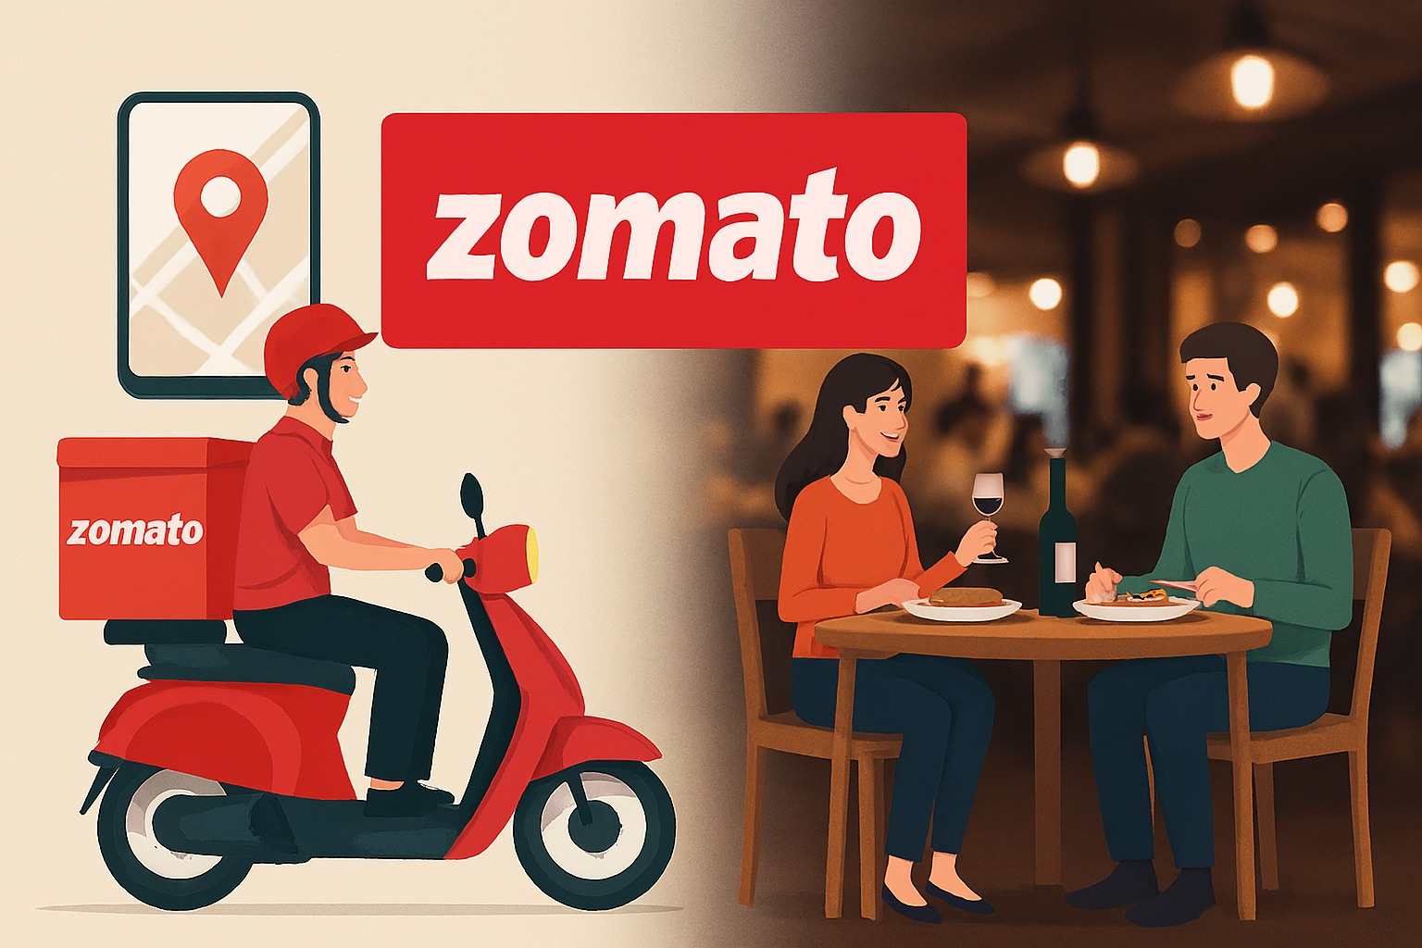
Introduction
Online food delivery platforms like Zomato rely on ranking algorithms that directly influence customer choices and restaurant visibility.
The study focuses on empirical analysis of Zomato’s live ranking behavior under different filters.
Data was collected over three days at three-hour intervals (10 AM – 10 PM) to capture ranking dynamics.
Filters applied include relevance + delivery time (under 30 mins), ratings (3.5+ & 4.0+), promotions (BOGO & deals), and price ranges (under ₹250, ₹250–350, above ₹350).
Data was organized using Excel and visualized with Power BI to identify trends and patterns.
Preliminary findings suggest that relevance sorting favors high-rated restaurants with active promotions.
Ranking is further influenced by pricing and delivery filters, which may introduce biases in visibility.
The study aims to provide insights into algorithmic transparency and highlight implications for restaurants, consumers, and platform optimization.

Slide 4
Literature
Restaurant ranking strongly affects visibility and sales, often reinforcing a “rich-get-richer” cycle where popular restaurants maintain dominance [1].
Recommender system studies in e-commerce stress the need to balance personalization with fairness, ensuring both new and established sellers gain exposure [2].
In food delivery platforms, delivery time, discounts, and customer ratings emerge as key factors driving restaurant placement [3].
Research highlights that ranking systems must adapt in real time to reflect changing consumer demand patterns [4].
Promotional strategies such as “Buy 1 Get 1 Free” and “Deals of the Day” significantly improve restaurant visibility and user engagement [5].
Pricing tiers (low, medium, high) influence ranking outcomes, shaping consumer preferences and restaurant competitiveness [6].
Overall, prior studies show that ranking is shaped by both algorithmic logic and market forces, blending consumer behavior, economic incentives, and contextual filters.

Slide 5
Tools/Methods
Zomato Android app was used to collect real-time restaurant ranking data under different filters.
MS Excel helped in basic data cleaning and structuring before deeper analysis.
NumPy and Pandas were applied for efficient data handling, preprocessing, and exploratory analysis.
Matplotlib and Seaborn were used to create visualizations of delivery times, offers, ratings, and distance impacts on rankings.
Data was collected over three days at three-hour intervals (10 AM–10 PM) using eight filters, including ratings, promotions, price ranges, and delivery time constraints.

Slide 6
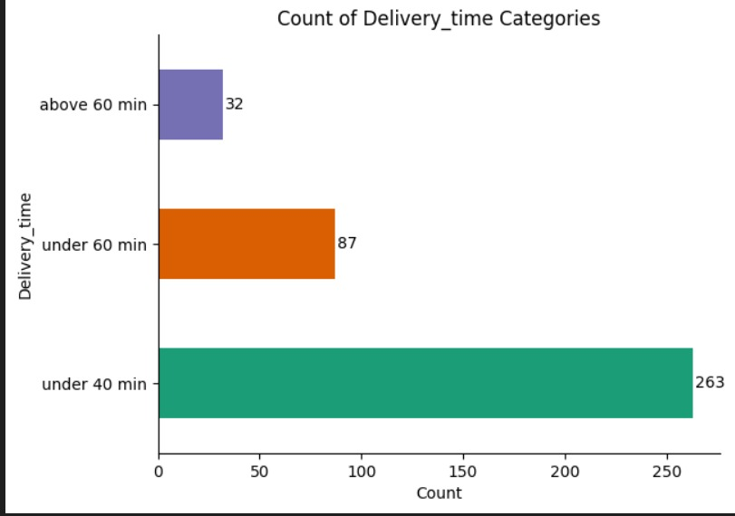
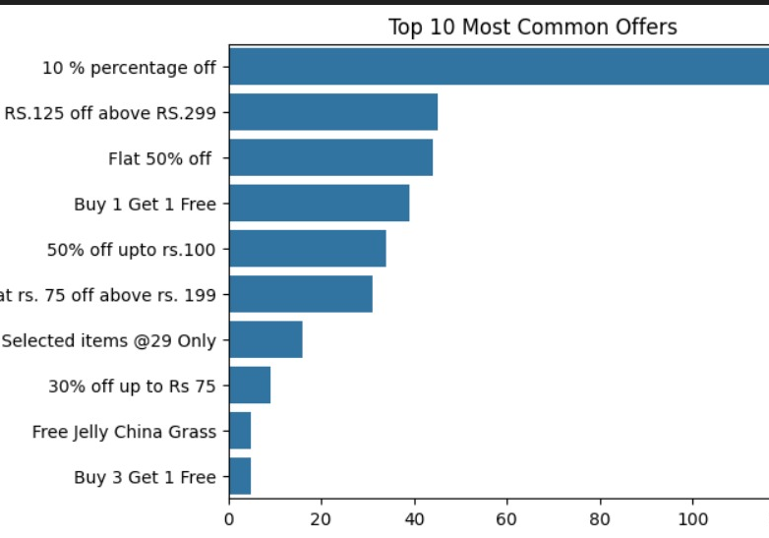
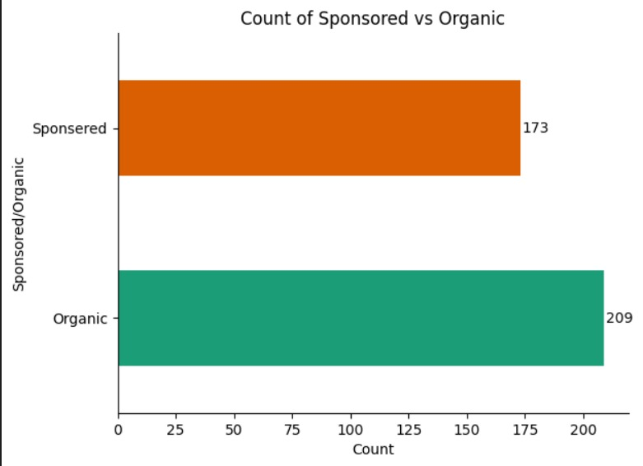
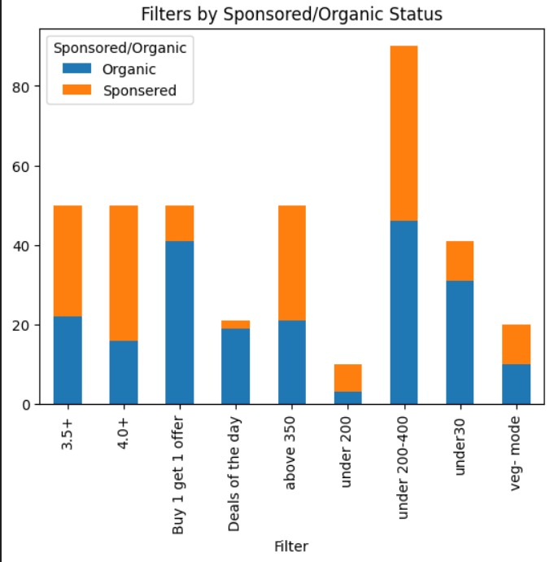
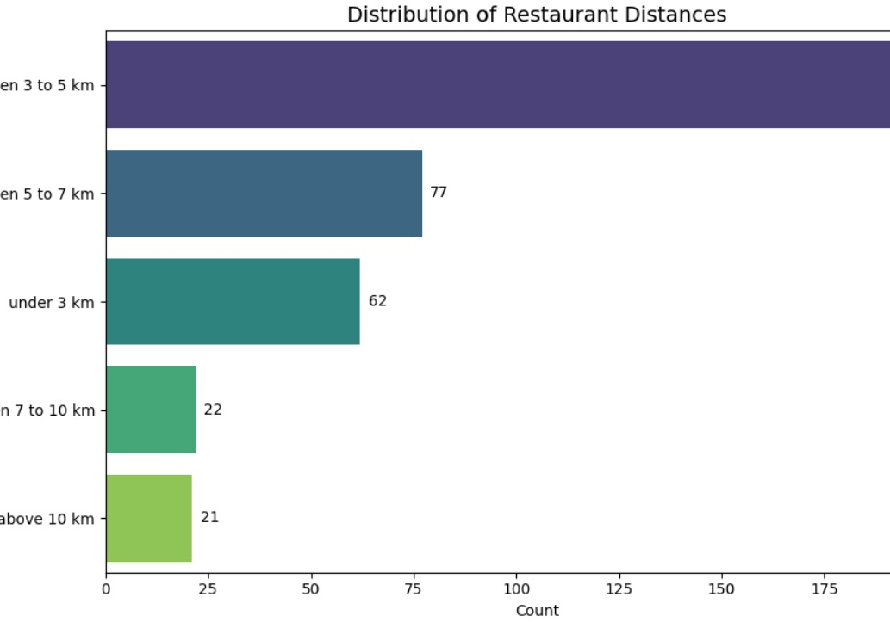
Results and discussions
The graph 1 shows that most deliveries (263) are completed within 40 minutes, while only a few (32) take more than an hour.
⚡ Impact on ranking: Restaurants with faster delivery times are ranked higher on Zomato, as speed directly improves customer satisfaction and order likelihood. 🚀
The graph 4 shows 209 organic restaurants vs. 173 sponsored ones.
⚡ Impact on ranking: While organic restaurants rely on ratings, delivery speed, and offers to appear higher, sponsored restaurants get priority placement because they pay for visibility, often appearing at the top regardless of performance
Graph 1
Graph 2
The graph 2 shows the top 10 most common offers on Zomato. The most frequent is 10% off, followed by flat ₹125 off above ₹299 and flat 50% off. Offers like Buy 1 Get 1 Free and discounts on specific amounts are also popular, while niche offers (like free jelly) are rare.
⚡ Impact on restaurant ranking:
Restaurants with attractive and frequent offers (like 10%–50% off or BOGO deals) are pushed higher in listings because they attract more clicks, higher conversions, and repeat orders. Simply put: better offers = better visibility & higher ranking.
Graph 4
The graph 5 shows restaurant filters split by organic vs. sponsored listings. Most visibility comes from filters like under ₹200–400, ratings (3.5+/4+), and offers (BOGO, deals of the day), with a big share boosted by sponsorship.
⚡ Impact on ranking: Sponsored restaurants get priority placement in these popular filters, while organic ones depend on ratings, pricing, and offers to appear higher.
Graph 5
From Graph 3 we can observe, Most restaurants (200) are located within 3–5 km, while very few (43) are beyond 7 km.
⚡ Impact on ranking: Restaurants closer to the customer (under 5 km) are ranked higher on Zomato since they ensure faster delivery and better customer experience, while distant ones appear lower unless highly rated or promoted
Graph 3

Slide 7
Conclusion
Zomato’s rankings are driven by delivery time, ratings, promotions, and distance.
Sponsored listings often appear higher regardless of organic performance.
High-rated restaurants with active deals consistently dominate top results.
The system reflects a mix of consumer preferences and platform-driven biases.
Greater algorithmic transparency and fairness are needed for balanced visibility.

